Slide 1
Learning Circle

Slide 2
The Four Steps
The Four Capacities
Guidance

Slide 3
Learning is like rowing upstream: not to advance is to drop back.
- Chinese Proverb

Slide 4
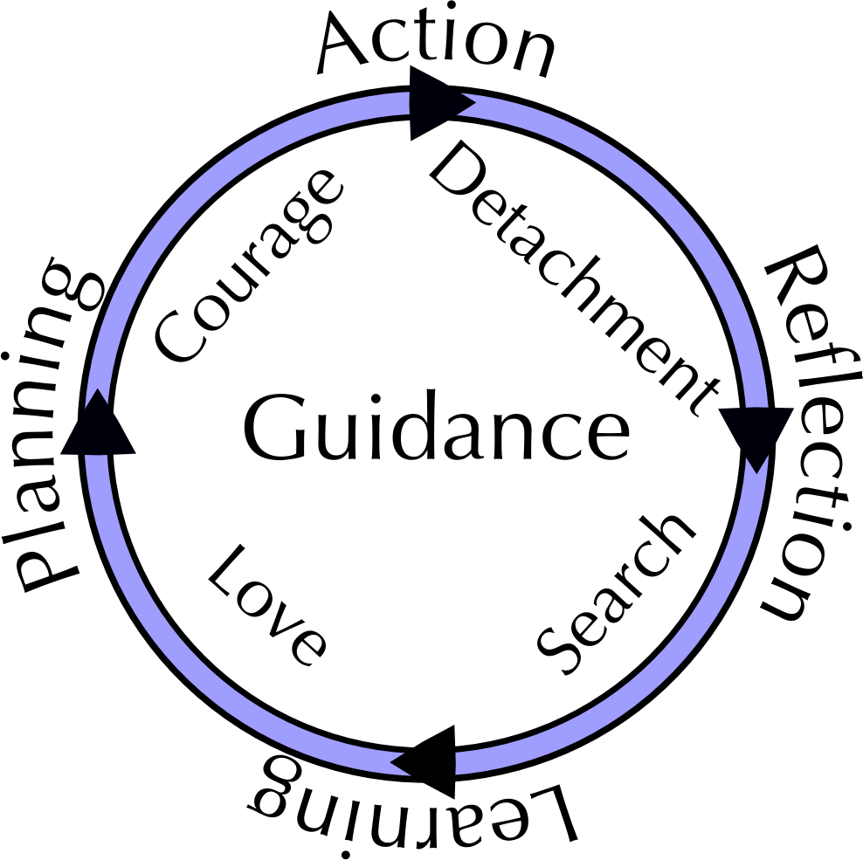
Notes:
The Learning Circle is a model of effective learning
Four steps:
Reflection, Learning, Planning, Action
Four capacities:
Detachment, Search, Love, Courage
The pivotal importance of Guidance

Slide 5
Exercise:
The Four Steps
Notes:
Reflection: Pause, Gather data, impressions, history, stories and any other observations about what we have done - Detachment from preconceived notions
Learning: Carefully examine observations made in Reflection step, “Discover” new insights, skills, relationship, structures, failures or any other conceptual changes - Search for principles involved in our work
Planning: Articulate conceptual understandings, Learning shapes the plan - Love for the work and the act of learning
Action: Implement the plan, Do work - Courage to plunge into the unknown

Slide 6
The Four Capacities

Slide 7
Detachment
http://common.tycoonresearch.com/assets/image/04092008_bbmonk.jpg

Slide 8
Search
www.cobbcat.org/images/OneSearchGlass.jpg

Slide 9
Love
http://lisawatkins.files.wordpress.com/2009/05/woman-gardener.jpg
Notes:
Supports the Planning step
Creates openness to Guidance
Engenders vision, passion and a sense of purpose.

Slide 10
Courage
www.beetlebugs.net/shop/images/lion.jpg
Notes:
Supports the Action step
Encompasses conscious choice, volition, willingness, and desire to act in the face of uncertainty

Slide 11
Guidance
http://www.manywallpapers.com/pop_preview.html/-/p/earth-and-sun/id/74587

Slide 12
O
Notes:
Any questions or comments?

